Slide 1
Dec 8, 2023
BBBSEM x IUCG: Modernizing Making A Difference
Phase 2: Acting upon identified roadblocks in onboarding process
Spencer Friedman, James Stevens, Meredith Greayer, Sankalp Koripalli, Selvana Abdelmesih

Slide 2
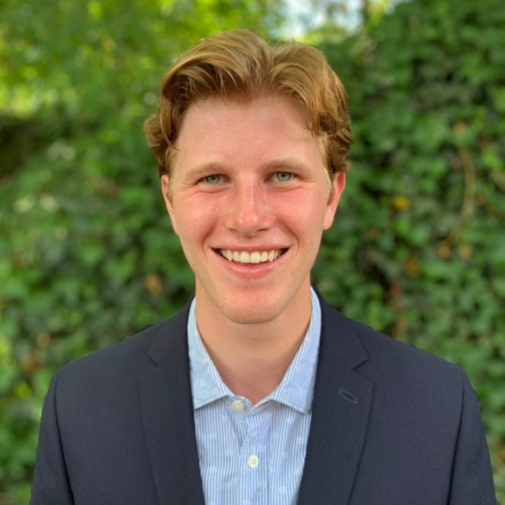

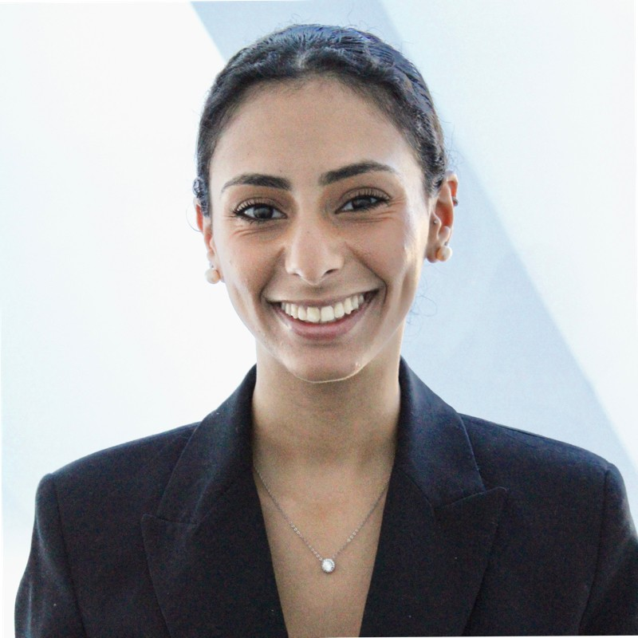
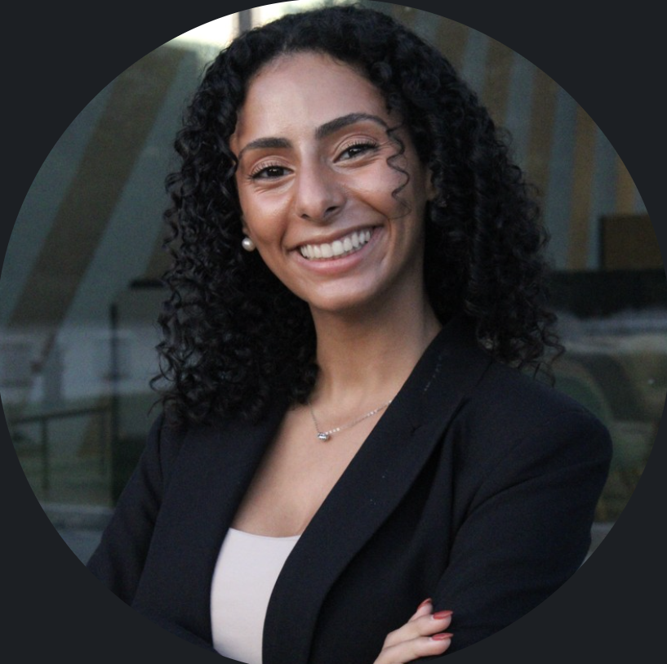

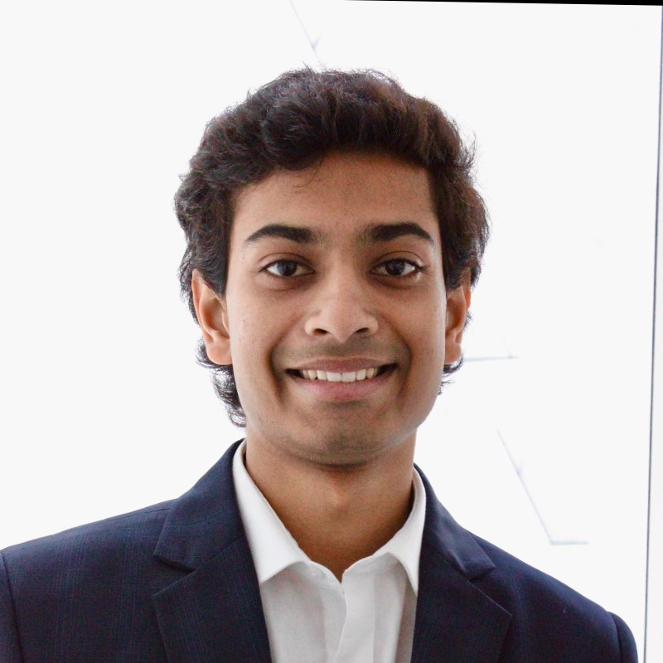
Meet the Team!
Spencer Friedman
Project Manager
Informatics ‘24
James Stevens
Senior Advisor
Accounting ‘24
Selvana Abdelmesih
Senior Analyst
Finance + Political Science ‘24
Meredith Greayer
Analyst
Mathematics ‘25
Sankalp Koripalli
Analyst
Economics ‘26

Slide 3



IUCG diagnosed and tackled key roadblocks identified through a systematic review of communications
Problem Statement
Outdated communication processes at BBBSEM underscore the need for a comprehensive review and strategic refinement to ensure a seamless volunteer onboarding experience
Consequences
Top of Funnel:
Recruiting and Marketing
Approach
Goal misalignment both internally and with candidates
Conduct holistic review of all flows and media in pipeline
Facilitate BBBSEM stakeholder interviews to identify root of problems faced by organization
Curate revisions and strategy for identified roadblocks
Middle of Funnel:
Pre-Interview
Lost engagement leading to suboptimal retention rates
Generic messaging contributing to a subpar volunteer experience
Bottom of Funnel:
Post-Interview

Slide 4
Executive Summary
Workstreams
Issue Statement
Actions
Results
1
Early Inquiry Journey
Lack of clarity around CEE and CRS interaction and handoff
Discrepancy between CEE form objective and messaging
Analyzed recruiting and marketing material
Addressed breakdown in CEE to CRS handoff
Evaluated CEE form objectives and effectiveness in recruiting
Curated feedback on concision and clarity of material
Provided introduction of CRS in presentation and emails
Developed edits to CEE form description and flow
2
Volunteer Task Communication
Ambiguity in pre-interview email task objectives
Ineffective messaging leading to incomplete assignments
Established best practices for pre-interview communications
Revised current content with action-oriented tone and structure
Addressed additional roadblocks in inquiry journey
Created updated flow with edited, action-oriented email content
Added additional day-of email reminder to pre-interview flow
Refined plans for A/B testing of new material
3
Post-Interview Standardization
Varied skillsets and standardization created irregular post-interview experience for candidates
Missing opportunities for engagement in post-interview
Established objectives and content for post-interview communication
Created standardization for enrollment coordinator tasks
Established long-term engagement methods
Proposed standardization of post-interview process
Established communication protocol to engage candidates
Developed strategies of involvement for long-term holds

Slide 5
Agenda
Optimizing Lead Generation Efforts
1
Identifying improvements to marketing and recruiting material
Addressing ambiguity around CEE form completion
Suggesting improvements in CEE to CRS hand-off
Improving Early Engagement
2
Presenting best practices and changes to email content
Offering recommendations to speed up form completion
Introducing plan for testing of new material
3
Establishing Post-Interview Transparency
3
Evaluating opportunities for automation of staff processes
Instating proposed standardization of post-interview flow
Proposing alumni panel for long-term engagement strategy

Slide 6
Optimizing Lead Generation Efforts
Optimizing Lead Generation Efforts
1
Identifying improvements to marketing and recruiting material
Addressing ambiguity around CEE form completion
Suggesting improvements in CEE to CRS hand-off
Improving Early Engagement
2
Presenting best practices and changes to email content
Offering recommendations to speed up form completion
Introducing plan for testing of new material
3
Establishing Post-Interview Transparency
3
Evaluating opportunities for automation of staff processes
Instating proposed standardization of post-interview flow
Proposing alumni panel for long-term engagement strategy

Slide 7





Best practices dictate that redesigning the marketing and recruiting material will enhance viewer interest
By revising wording, using action words and avoiding potential confusing lingo, BBBSEM will see clearer communication ultimately resulting in higher conversion rates.
Marketing Best Practices
Awareness of audience
Marketing Ads
Recruiting Flyers
Include a Call-to-Action like ‘Tap on the link to sign-up’
Decrease repetition of words like ‘mentor’, ’learn more’
Remove nuanced lingo used like ‘it takes little to be big’
Make more action-oriented like ’Don’t wait! Reserve spot today’
Make clear Call-to-Action
Create a story-like flow to flyers sequentially
Remove unnecessary graphics like arrows
Reduce repetition on words like ‘learn more’
Reduce the size of the target company image on flyer
Strong visual appeal
Hierarchy of information

Slide 8



Revising CEE form and attaching it to website will reduce confusion and facilitate increased event requests
Changes to CEE form description and structure resolve confusion around the “Post-Event RSVP” and improve transition to scheduled interview.
CEE Form
Form Visibility
Revise CEE form description to clarify use after an event has taken place
Allow inquiring companies to navigate to CEE form from Events page of website
Immediate
Future
Transition to new CEE form ensures better user experience and information retrieval
Advertise events through marketing to host events with BBBSEM

Slide 9



Explicit introduction of CRS by CEE allows handover to be facilitated smoothly and clears up ambiguity
CEE Presentation
Email Handover
Guidelines for Nudges
Website & Chatbot
Develop a slide in the CEE presentation to introduce CRS mentioning Rebecca and Denise
The last email sent from CEE should include an introduction of CRS and the individuals to contact*
CEE team should get 24 hours to nudge candidates before gets handed off to CRS
Solution
Volunteers will be introduced CRS at first point of contact
Adequate awareness of the CRS in later communication
Leads will be well informed of change in point of contact
Existence of a complete and defined transfer to CRS
Creation of set guidelines between CEE and CRS teams
Reduces chance of overlapping emails creating confusion
Impact
Establishing guidelines and a 2-step introduction ensures systematic volunteer communication and smooth transfer protocols, thereby increasing awareness and understanding within the teams.
*Refer to Appendix A

Slide 10
Improving Early Engagement
Optimizing Lead Generation Efforts
1
Identifying improvements to marketing and recruiting material
Addressing ambiguity around CEE form completion
Suggesting improvements in CEE to CRS hand-off
Improving Early Engagement
2
Presenting best practices and changes to email content
Offering recommendations to speed up form completion
Introducing plan for testing of new material
z
3
Establishing Post-Interview Transparency
z
3
Evaluating opportunities for automation of staff processes
Instating proposed standardization of post-interview flow
Proposing alumni panel for long-term engagement strategy

Slide 11




Current email flows lack urgency and direction that encourages volunteer completion
Action-Oriented
Repetitive email headers and outdated content deters potential volunteers from understanding communication purpose
Implementing varied subject lines and orienting verbiage to flow goals offer volunteers opportunity to engage with BBBSEM
Email Design and Content
Prioritized
Email structures unaligned with communication goals prevents volunteers from clearly and quickly identifying purpose
Restructuring emails to prioritize necessary content (forms, schedulers, zoom links) creates a clear and straightforward volunteer experience
Creating goal-oriented communications with attentive subjects and prioritized content could inspire increased volunteer engagement and conversion rates.
Included Media
Inclusion of a single BBBSEM social media in pre-interview communication limits possibility for volunteers to engage online
Varying media and social platforms offers volunteers varied opportunity to engage with BBBSEM on their preferred social site
*Refer to Appendix B for Pre-Interview Emails

Slide 12



Defining volunteer and reference expectations will better facilitate pre-match requirements
IUCG identified three opportunities to improve BBBSEM volunteer timelines and expedite requirements necessary to be marked eligible for match.
Form Expectations
Incomplete forms lengthens flow process and leads to missed interviews
Editing language around form assignments to identify purpose and time necessary encourages volunteers to complete forms quicker
Word Count
Lack of reference word counts slows post-interview process
Adjusting prompts and adding word counts will further define expectations and accelerate post-interview process
Operational Efficiency
Addressing friction points along flows offers BBBSEM opportunity to accelerate volunteer interview and matching processes.
Cadence
Current flow cadence limits volunteer potential to attend interview
Creating an additional, day-of email reminder for scheduled interviews offers fewer opportunity for volunteers to forget their reservation
*Refer to Appendix B for Pre-Interview Emails

Slide 13
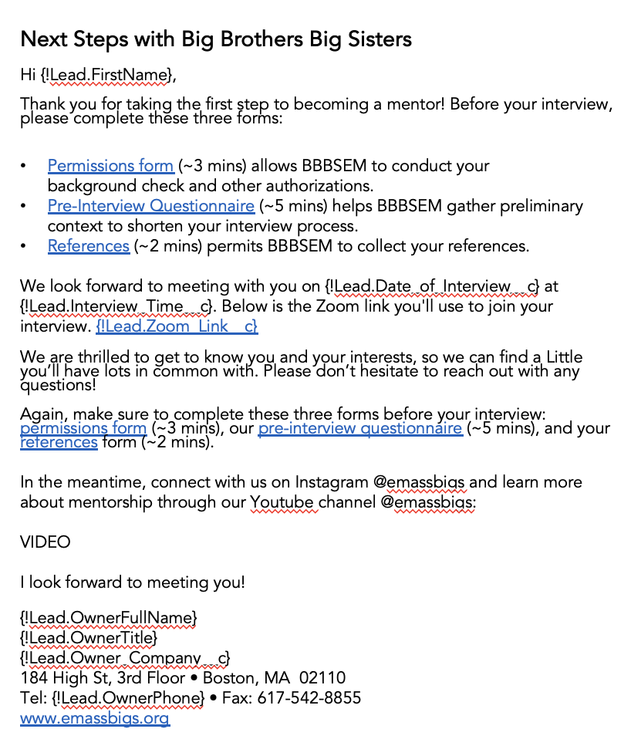

Accelerating volunteer application timelines through verbiage and email content prioritization
IUCG suggests specific edits to pre-interview communications to encourage form understanding and completion, increase volunteer social media engagement, and improve email clarity.
Action-oriented subject line verbiage, with attention to first few words and varied subjects across flow
Required forms identified immediately with form time estimates and expectation summary beside each assignment
Interview Efficiency
Zoom link prioritized second and omitted “video chat”
Refocusing pre-interview communications from zoom confirmations to action-required next steps will optimize open rates and improve volunteer timelines
Forms mentioned again
Social media engagement encouraged at the close
*Refer to Appendix B for Pre-Interview Emails

Slide 14



Evaluating IUCG’s suggestions by A/B testing will inform implementation decision making
Testing IUCG’s revised emails and flows through evaluation of several criterion will compare effectiveness of hypothesized best practices and potentially increase volunteer conversion rates and overall satisfaction.
A/B Test
Send flows to equal # of volunteers - if from a recruiting event, split cohort in half
Single or separate tests:
IUCG created immediate to scheduled to interview confirmation
IUCG created interview confirmation separately evaluated
IUCG Flows
Cadence maintained in Volunteer Immediate/Scheduled Actions
Cadence adjusted to include day-of reminder in Interview Confirmation
Subject headings edited to be varied in all flows
Verbiage adjusted to reflect email best practices, as discussed in previous slides
IUCG created 3 revised flows located in Sandbox: “IUCG TEST {original title}”
Evaluation
Measure effectiveness through comparing interview sign-ups, conversion rates, email open rates, pace forms completed, and polling volunteer satisfaction
Evaluate data reliability considering sample sizes
*Refer to Appendix B for Pre-Interview Flows

Slide 15
Establishing Post-Interview Transparency
z
Optimizing Lead Generation Efforts
1
Identifying improvements to marketing and recruiting material
Addressing ambiguity around CEE form completion
Suggesting improvements in CEE to CRS hand-off
Improving Early Engagement
2
Presenting best practices and changes to email content
Offering recommendations to speed up form completion
Introducing plan for testing of new material
3
Establishing Post-Interview Transparency
3
Evaluating opportunities for automation of staff processes
Instating proposed standardization of post-interview flow
Proposing alumni panel for long-term engagement strategy

Slide 16






Modernizing communications while maintaining long-term engagement can enhance volunteer satisfaction
Long-Term Engagement
Automating Assignments
Standardizing communication will decrease human error and allow for consistent messaging
Implement AI notetaker to increase efficiency and accuracy of interview assessment
1
3
Automating Communications and note-taking
Impact Driven Communications
Follow email best practices to demonstrate impact and maintain mission
Provide status updates to increase transparency and deliver valuable communications
2
Preserving Long-Term Engagement
Alumni Panel provides inspiration to volunteers by showcasing firsthand experience
Opportunity for BBBSEM to interact with volunteers while keeping them engaged
Post-Interview Communications

Slide 17

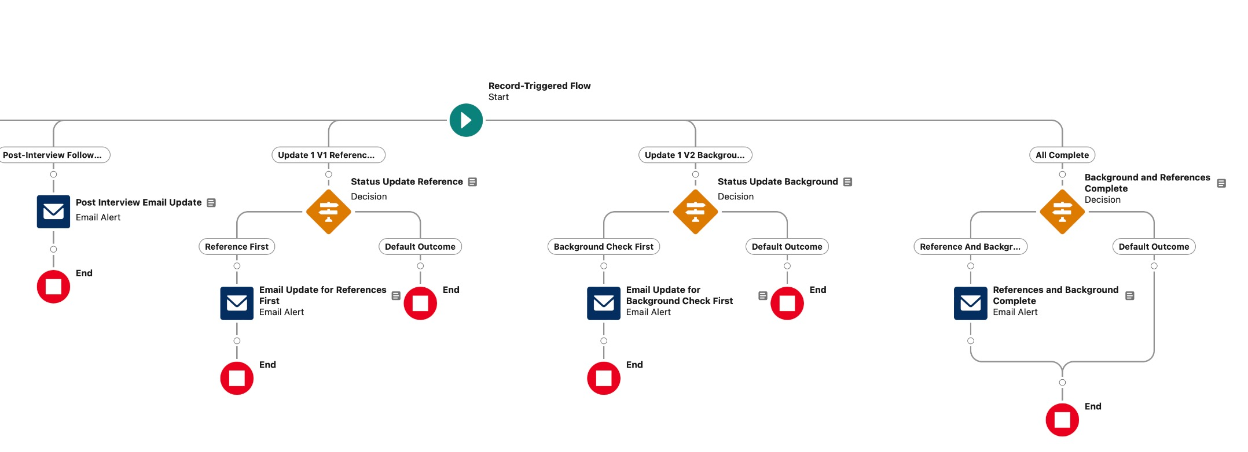
Standardizing post-interview communications will enhance user experience and ensure employee efficiency
Although the post-interview process is highly variable, informing candidates when tasks are completed will provide them with the peace of mind that the BBBSEM team is actively reviewing their application.
Automation
Automating communications will improve the overall quality of communications and volunteer satisfaction
Establishes consistency in messaging and increases efficiency by simplifying employee tasks
Ensures no critical details are overlooked
Flow Name: IUCG Test Post – Interview Flow 1
*Refer to Appendix C for Post – Interview Short-Term Flow

Slide 18




Utilizing AI represents an opportunity for BBBSEM to optimize the interview process and increase efficiency
Zoom’s preferential cost structure, industry-standard security, and ability to integrate with other services utilized by BBBSEM make it a strong option for using AI to accelerate the note-taking process.
Key Attributes of Projected Impact
AI Companion
Price
9
Security
8
Organizational Efficiency and Accuracy
Integrability
8
Ensures accurate documentation and reduces time on note-taking, addressing delays in assessment documentation, and reducing overall processing time
Price
5
Security
7
Industry Shift
Otter.ai
Integrability
9
46% of businesses utilize AI services for internal communications and 97% of business owners believe AI can help their business, enabling BBBSEM to modernize interview process
Price
5
Security
7
Integrability
9
Notes:
Zoom gives
Show captions option allows both sides to see the transcript

Slide 19





Interactions with volunteers should adhere to email best practices to maintain clear communication
Following Effective Email Guidelines
Emotion and impact driven language is essential because volunteers remain committed when they see tangible results
Personalized message with compelling subject line can prevent it from being overlooked
Clear structure with call to action highlighted is optimal for mobile view
Email Best Practices
Creating Valuable Content
Effective Email Standards
Provide Status Updates
Status updates foster transparency, keeping volunteers engaged and informed
Clear communication increases volunteer commitment, making them feel valued
Providing updated 3rd party content is an opportunity to showcase impact and optimize existing resources
Subject matter expert emphasizes impact-driven language and personalization for maximizing value
Including status updates will provide volunteer clarity around the process, enhancing overall volunteer experience

Slide 20
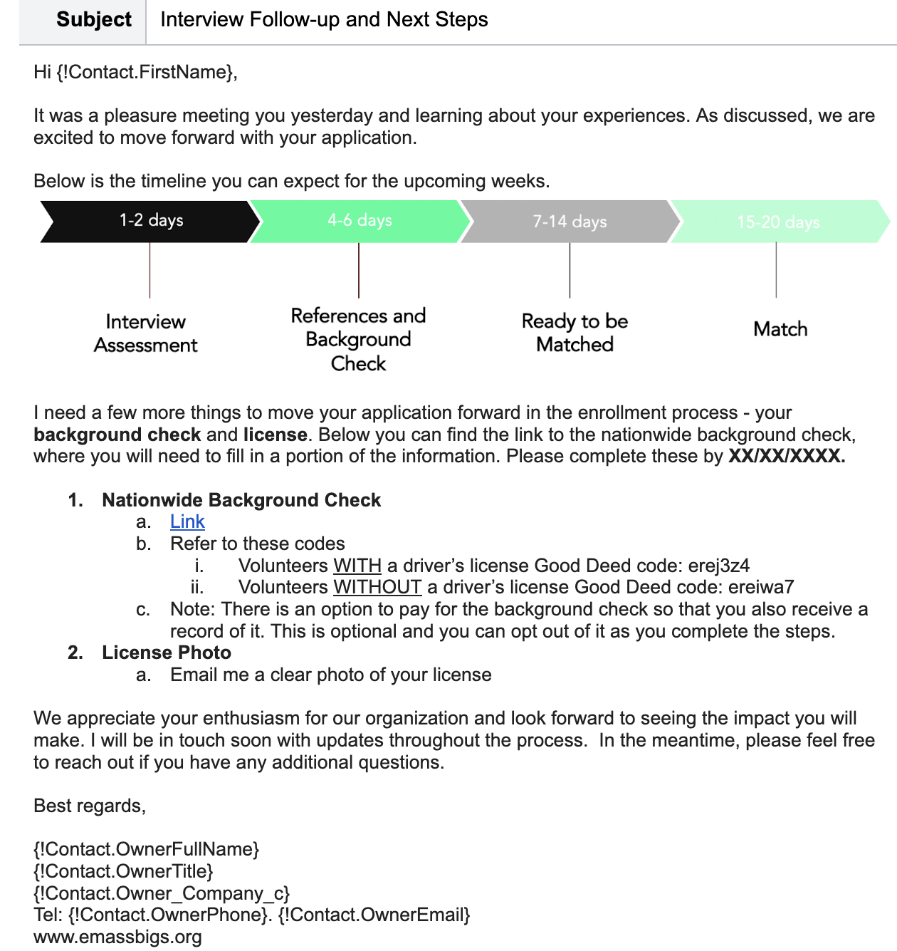
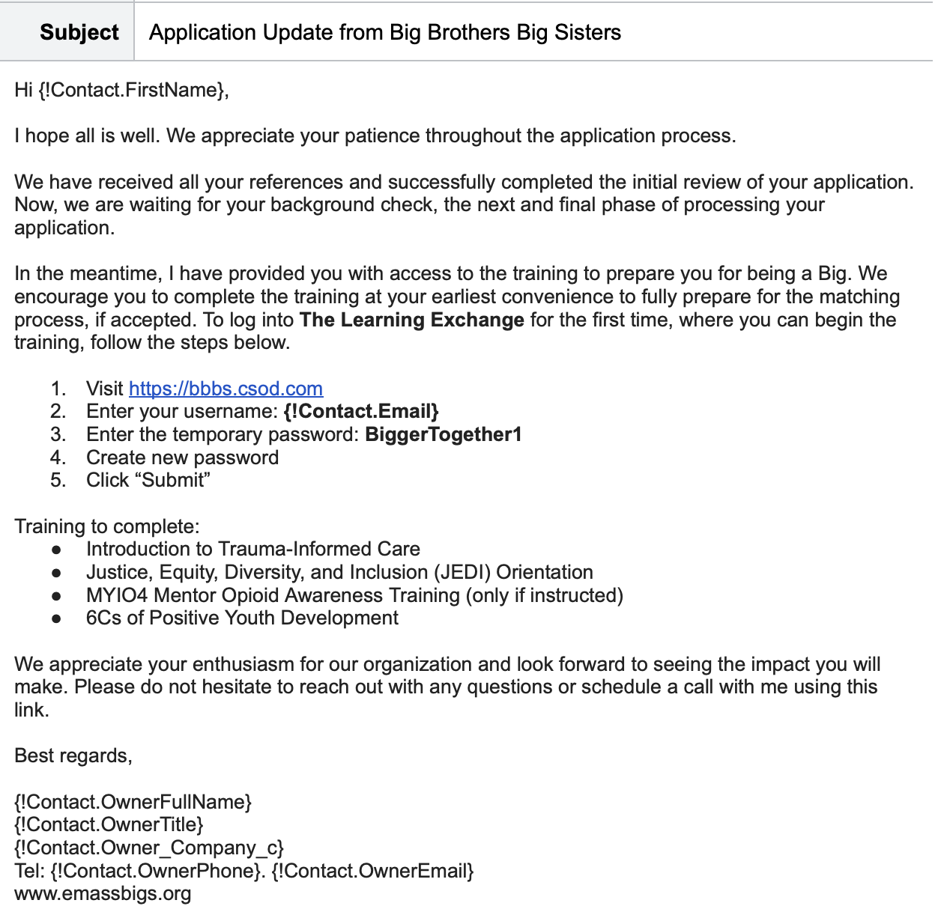
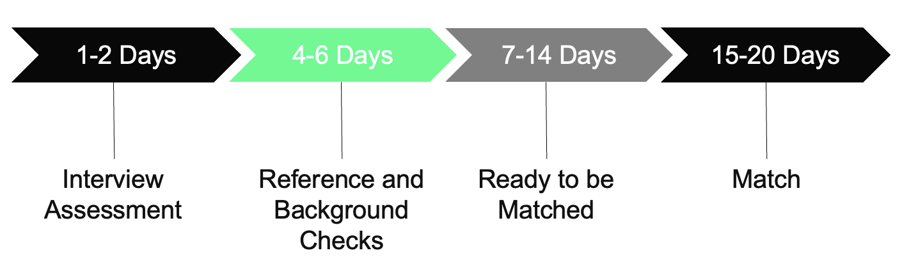
Example of updated emails adhering to best practices, providing timeline and transparency
Key changes include a personalized message with a timeline and clear updates provided, while using impact-driven language.
Personalization
Clear Updates
Communicate timeline
Clear Structure with a call to action highlighted
Impact driven
*Refer to Appendix C for Post – Interview Short-Term Communication Templates in Salesforce
Notes:
Subject line change in talk track

Slide 21
Alumni panel provides opportunity for BBBSEM to refine volunteer experience and overall retention
Virtual Alumni Panel
Community
Knowledge Sharing
Post-Event Engagement
Quarterly panels featuring graduated Big and their respective Little, famous Bigs and/or current Bigs
Interview style, begins with panelists introduction, structured questions to showcase impact, concluding with Q&A from audience
Targets those who are waiting to be matched, put on hold or new Bigs
Volunteers can feel connected to a larger network of individuals who share similar goals
Demonstrates that the organization values and appreciates its volunteers
Provides volunteers with valuable insights, improving quality of mentorship
Showcases long-term impact and offers inspiration, improving retention
Opportunity to collect feedback can be instrumental in improving overall volunteer satisfaction
Maintains excitement toward volunteering while waiting for match
Impact
Virtual Alumni Panel serves as a long-term engagement strategy that builds a sense of community, facilitates the exchange of knowledge and provides a valuable opportunity to collect feedback.
Conclusion

Slide 22
BBBSEM can improve conversions and volunteer experience by implementing new material and strategies
1
2
3
IMMEDIATE ACTIONS
SCHEDULED ACTIONS
LONG-TERM ACTIONS
Incorporate CRS introduction
Begin testing of new pre-interview flow and media
Finalize design of post-interview flow and test logic
Look into AI-Notetaker
Finalize implementation of new contact flow pre-interview
Begin testing of post-interview flow and AI notetaker
Implement changes to advertisements and flyers
Redesign ”Events” page to accommodate new organization inquiries
Plan and include Virtual panels in long-term engagement strategy
Continue updating relevant content in email and advertising
To Do’s
Key
Parties
Aka Denjongpa
Terry McCarron
Nick Ramos
Caitlin McNee
Terry McCarron
Nick Ramos
Kara Hopkins
Caitlin McNee
Caitlin McNee
Terry McCarron
Nick Ramos
Approx
Deadline
February 2024
April 2024
June 2024

Slide 23
Any Questions?

Slide 24
Appendix A: Interest to Inquiry

Slide 25
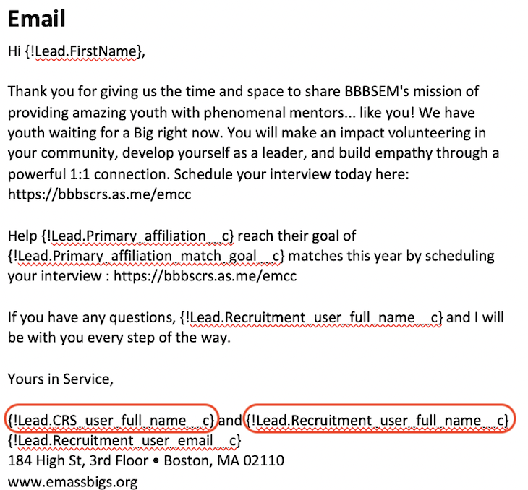
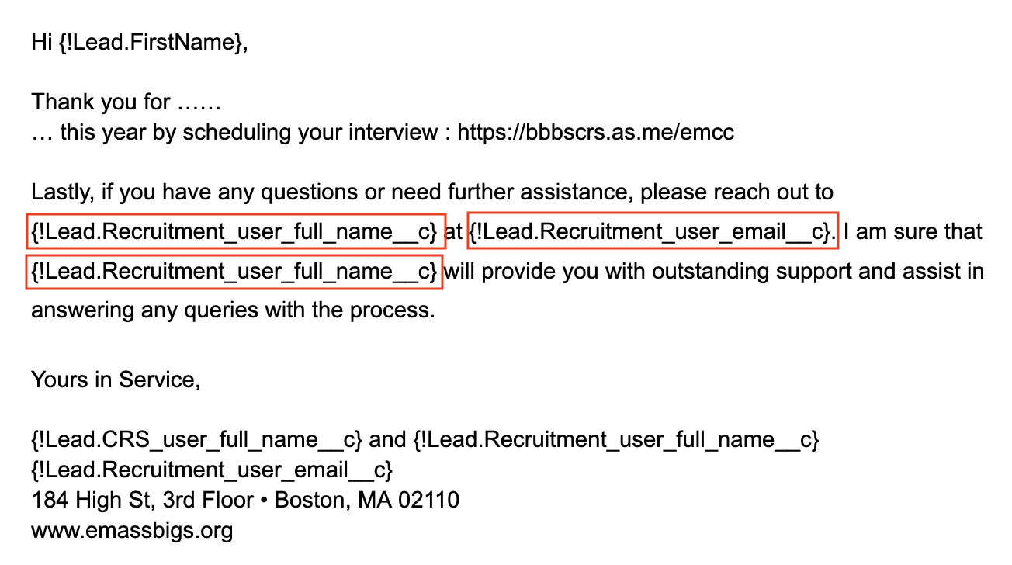
Appendix A: CEE Updated Email for Handover Process
Current CEE Email Outreach
Potential Revised Email Outreach

Slide 26
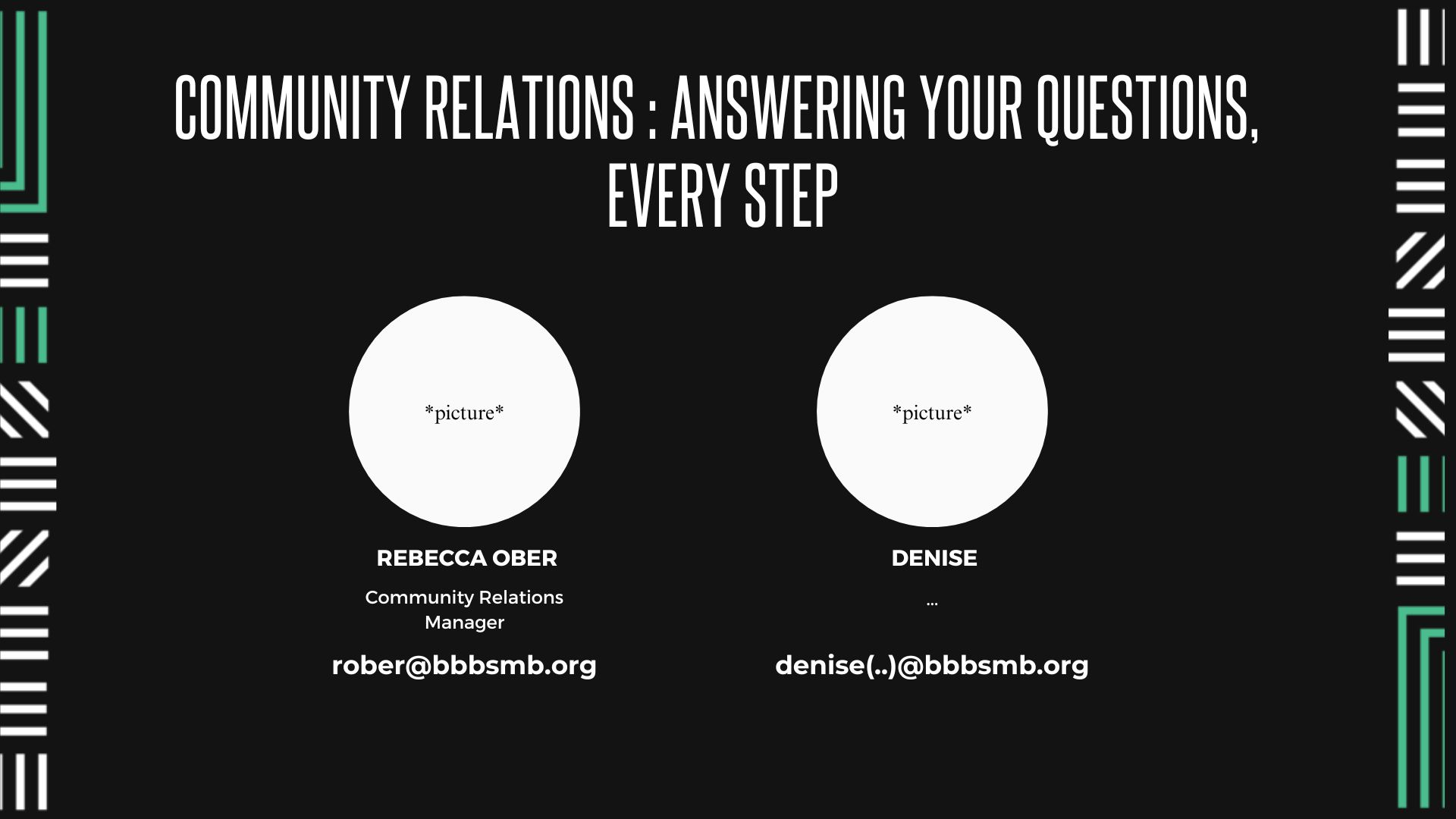
Appendix A: CEE Presentation: New Slide for Introducing CRS Team

Slide 27
Appendix B: Inquiry to Interview

Slide 28
Appendix B: Flow Sandbox Directory
IUCG TEST VIP mentor outreach 1
IUCG TEST VIP mentor outreach 2
IUCG TEST VIP mentor outreach 3
IUCG TEST VIP learn more outreach 1
IUCG TEST VIP learn more outreach 2
IUCG TEST VIP learn more outreach 3
IUCG TEST VIP no notes outreach 1
IUCG TEST VIP no notes outreach 2
IUCG TEST VIP no notes outreach 3
IUCG TEST VIP Email 1
IUCG TEST VIP Email 2
IUCG TEST VIP Email 3
IUCG TEST VOL Interview Booked / Confirmations Zoom PILOT
IUCG TEST VOL Interview Confirmation 2 Zoom PILOT
IUCG TEST VOL Interview Confirmation Final Zoom PILOT
* IUCG TEST Volunteer Outreach || Immediate Actions
* IUCG TEST Volunteer Outreach || Scheduled Actions
* IUCG TEST Interview Confirmation

Slide 29
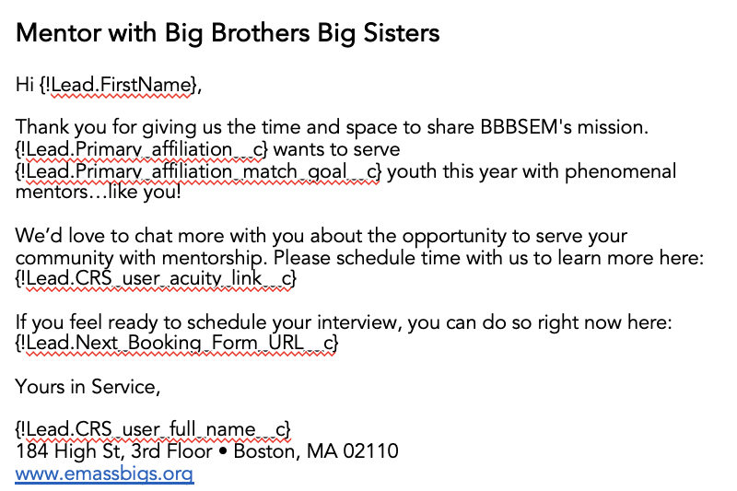
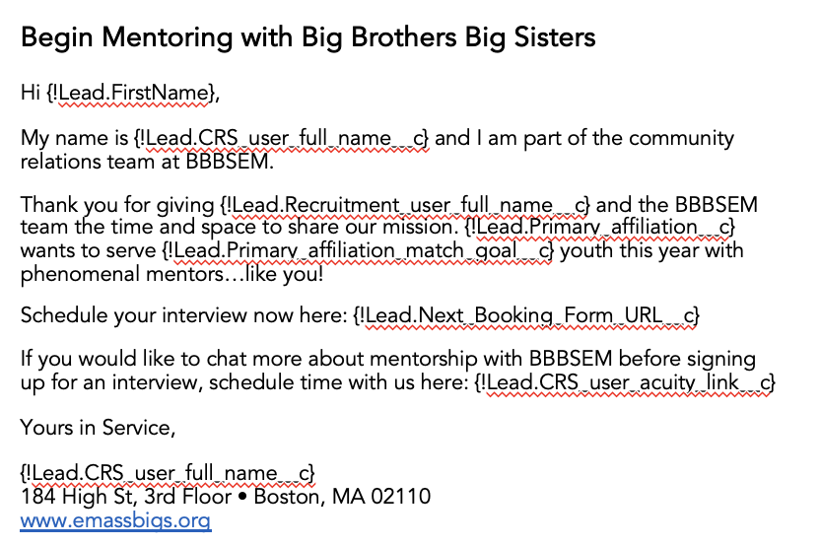
Appendix B: Volunteer Outreach Email 1
To Address CEE/CRS friction while implementing email best practices, IUCG suggests five specific edits to three volunteer communication flows to increase volunteer engagement.
Push to Chat (CRS): “IUCG TEST VIP no notes outreach 1”
Original
Adjusted
Titles edited to vary: three communications with unique subject headings
“Begin Mentoring…”
“Schedule an interview…”
“Start here to begin Mentoring…”
Action-oriented subject line verbiage, with attention to first few words
Immediate handoff from CRS from CEE through named introduction
Immediately post-thanks, interview acuity scheduler is linked
Acuity scheduler link for informational chat included after interview link

Slide 30
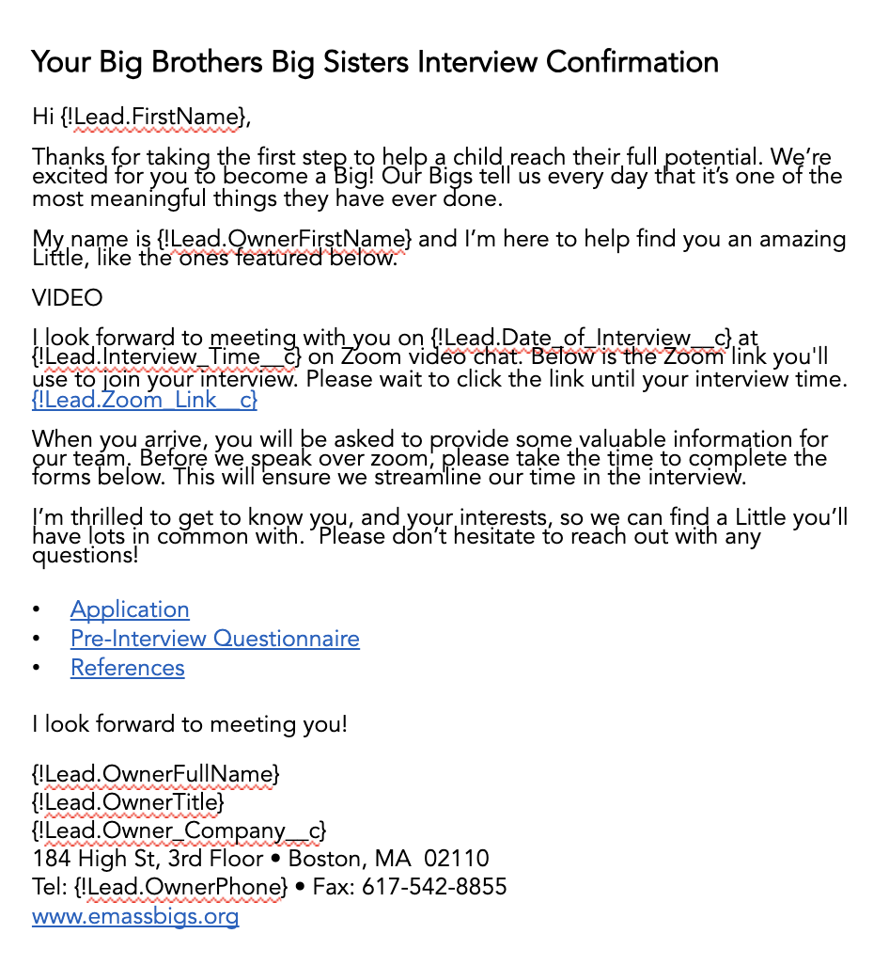
Appendix B: Pre-Interview Email 1
IUCG suggests seven specific edits to pre-interview communications to encourage form understanding and completion, increase volunteer social media engagement, and improve email clarity.
“IUCG TEST VOL Interview Booked / Confirmation Zoom PILOT”
Original
Adjusted
Titles edited to vary: four communications with unique subject headings
Action-oriented subject line verbiage, with attention to first few words
Required forms identified in first line and listed immediately
Form time-estimates and content summary included beside each assignment
Zoom link prioritized second, as Acuity Scheduler auto-message also includes link
Forms mentioned again at the end
Social media engagement encouraged at the very bottom of communication

Slide 31
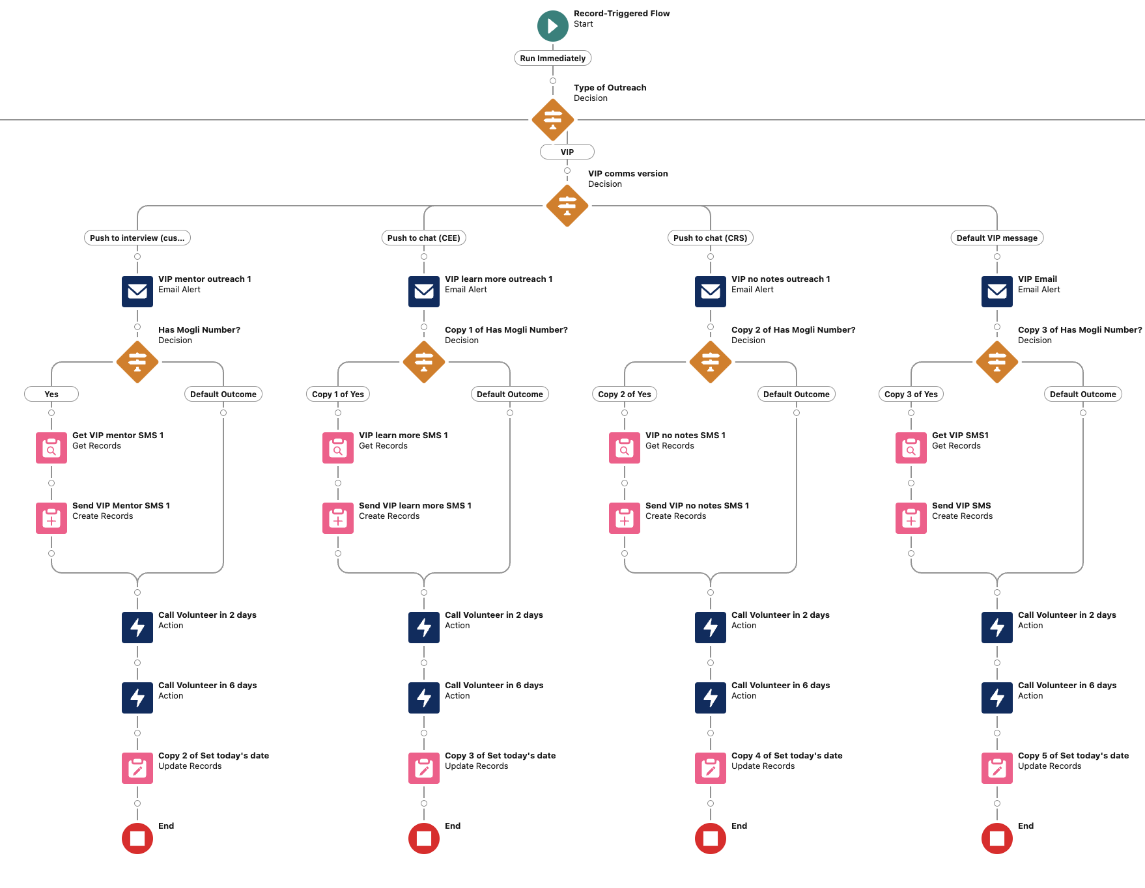
Appendix B: Volunteer Communications
Flow Name: IUCG TEST Volunteer Outreach || Immediate Actions

Slide 32
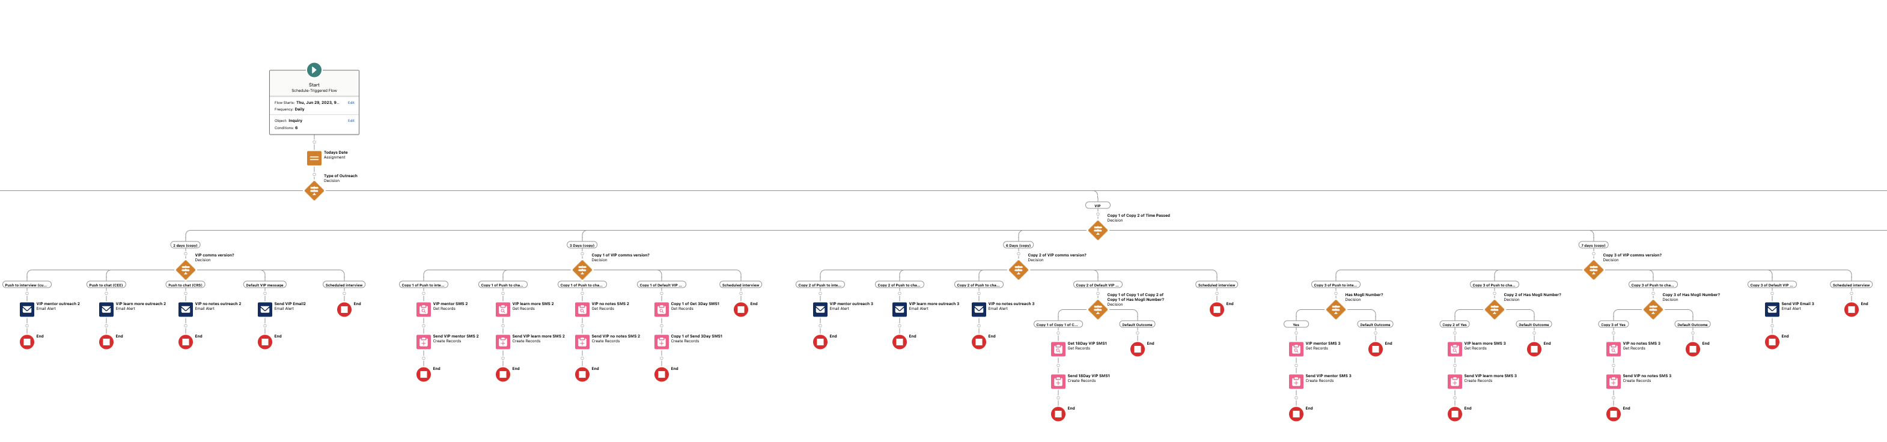
Appendix B: Volunteer Communications
Flow Name: IUCG TEST Volunteer Outreach || Scheduled Actions

Slide 33
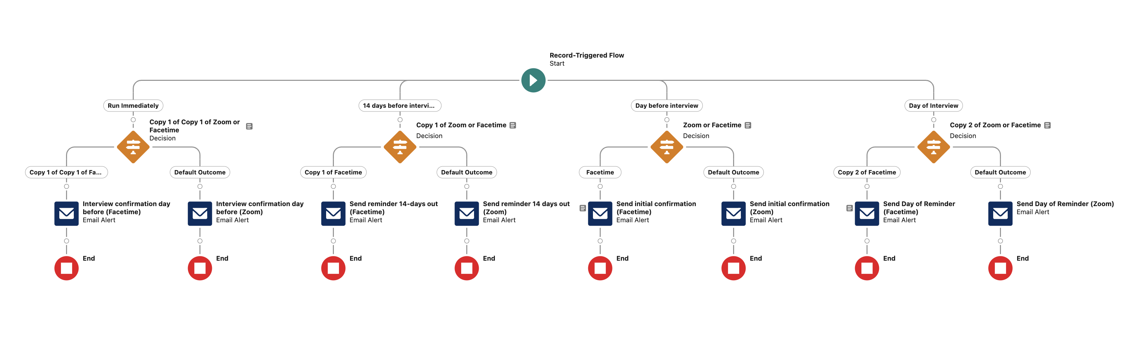
Appendix B: Interview Confirmation Flow
Flow Name: IUCG TEST Interview Confirmation

Slide 34
Appendix C: Post - Interview

Slide 35
Appendix C: Post-Interview Short – Term Communication Templates in Salesforce
Template Name: Volunteer Interview Follow-up
Flow Used: IUCG Test Post Interview Flow 1
Template Name: Volunteer Status Update 1 Version 2
Flow Used: IUCG Test Post Interview Flow 1

Slide 36
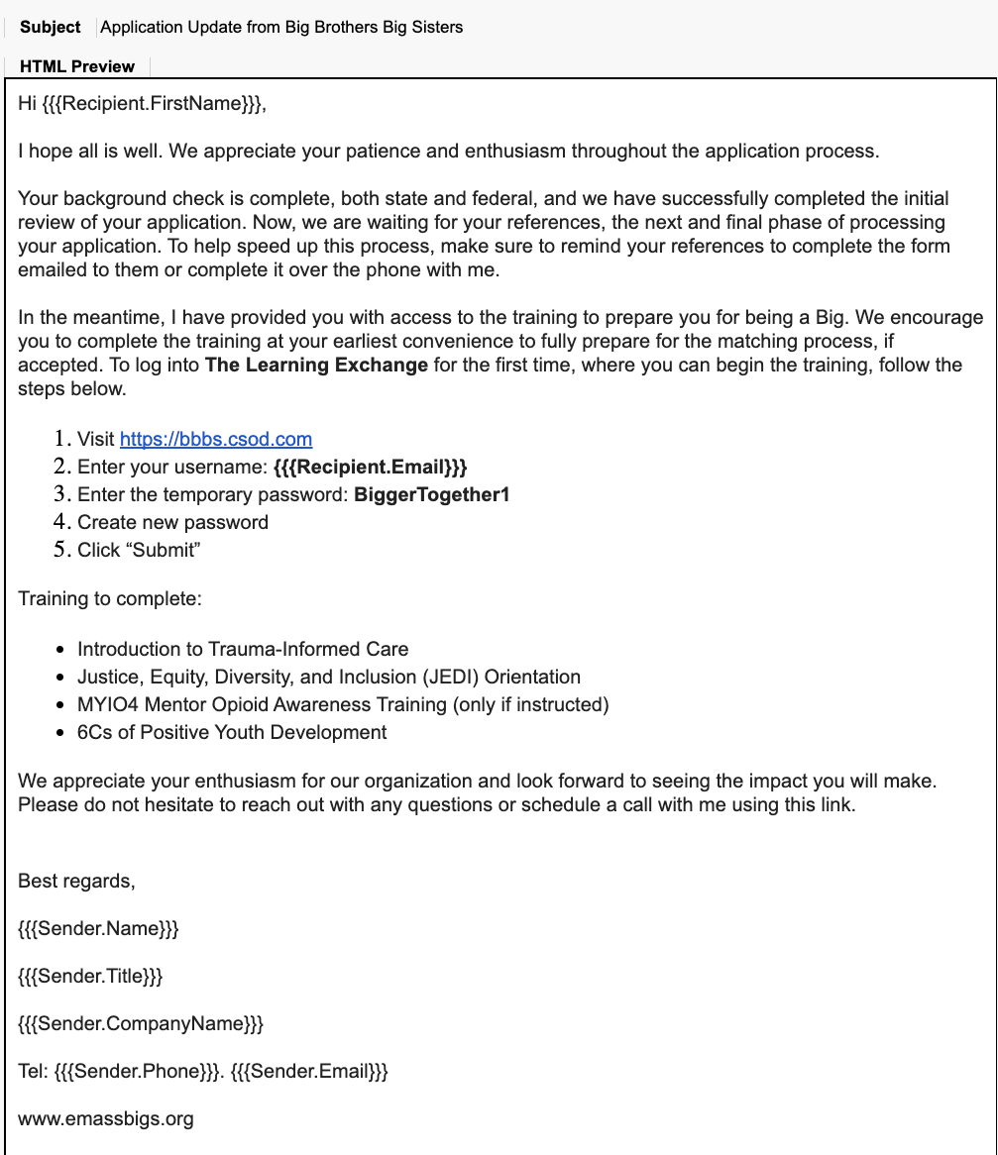
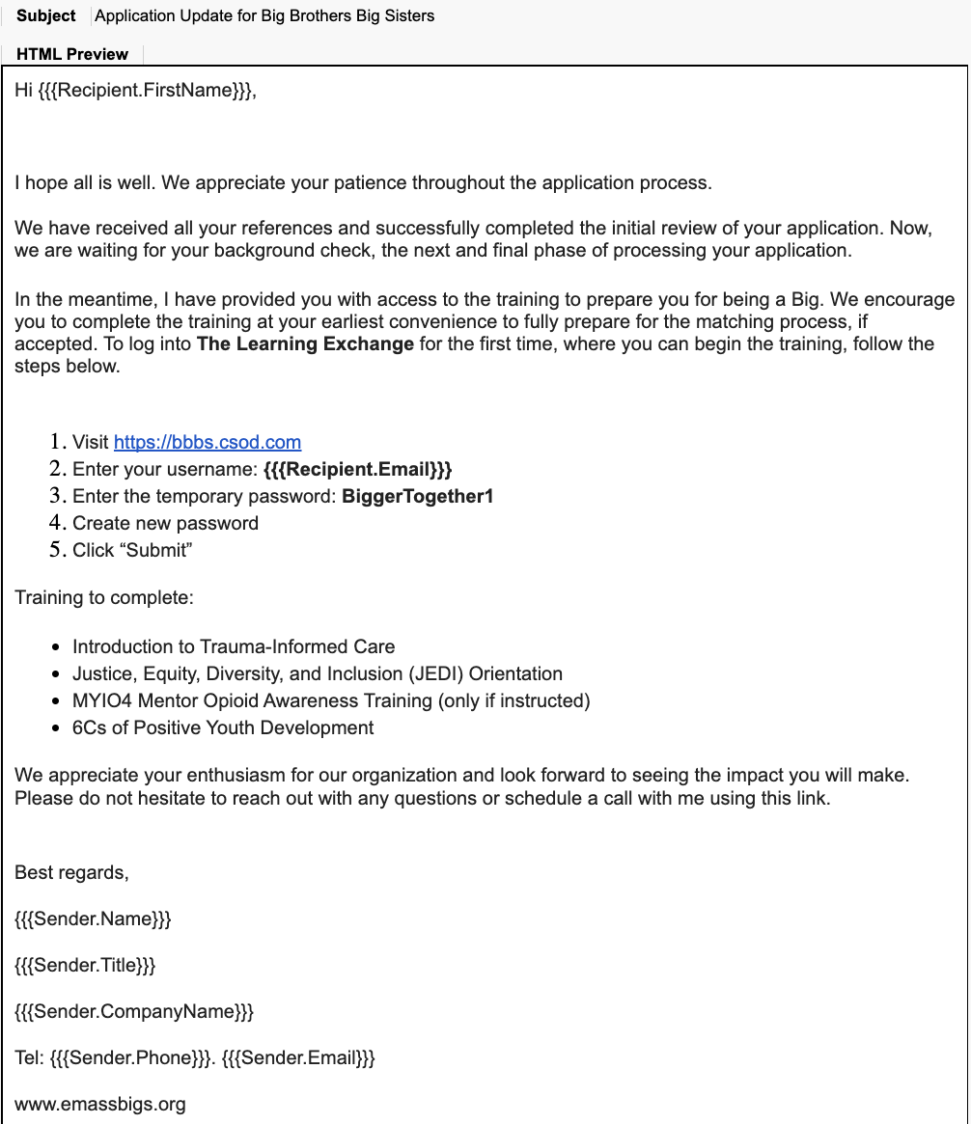
Appendix C: Post-Interview Short – Term Communication Templates in Salesforce
Template Name: IUCG TEST email update for background check completed
Flow Used: IUCG Test Post Interview Flow 1
Template Name: IUCG TEST Email Update for references completed
Flow Used: IUCG Test Post Interview Flow 1

Slide 37
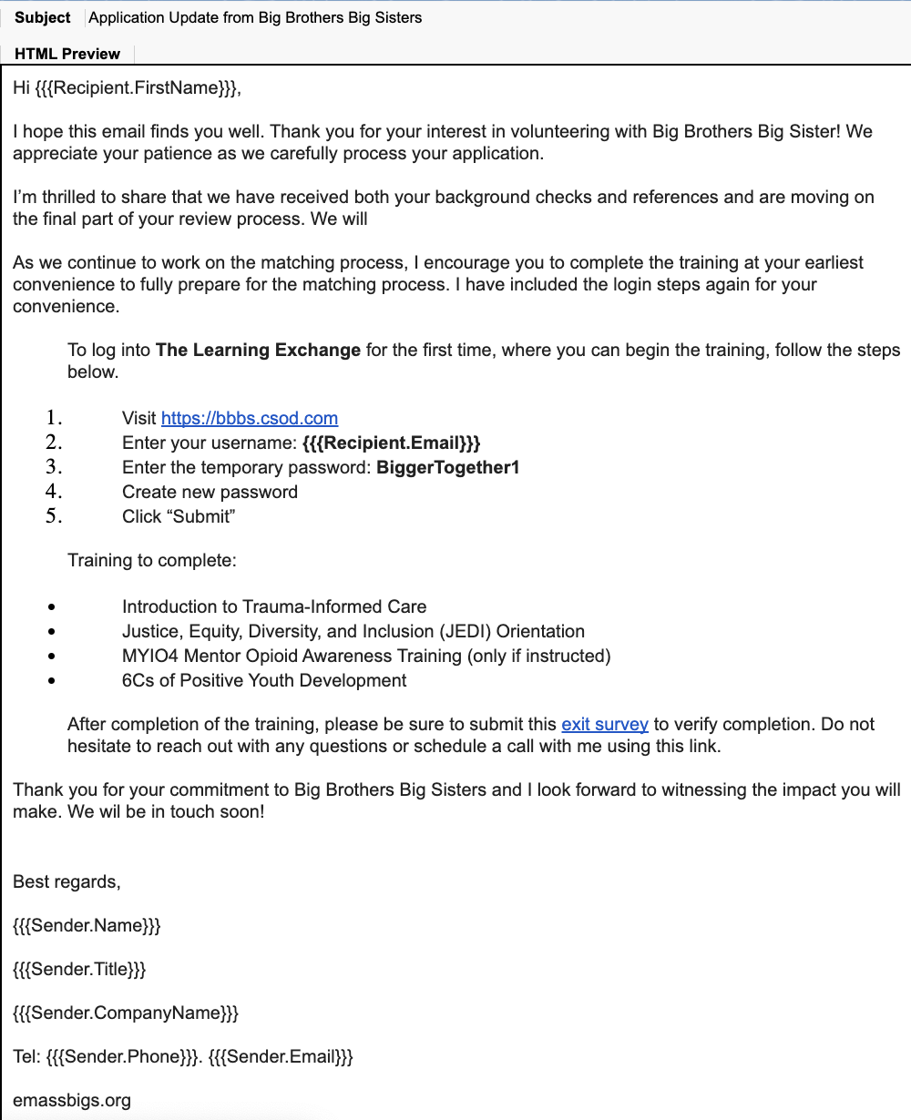
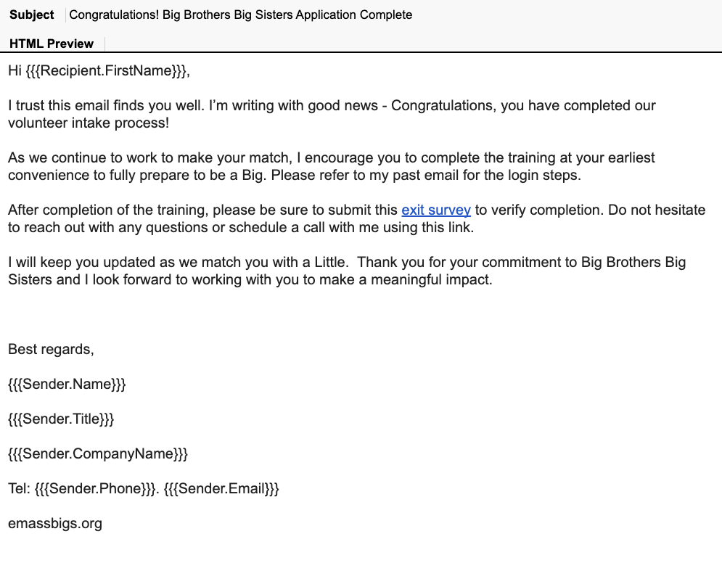
Appendix C: Post-Interview Short – Term Communication Templates in Salesforce
Template Name: IUCG TEST Email Update for Final update
Flow Used: IUCG Test Post Interview Flow 1
Template Name: IUCG TEST Email Update for RTBM
Flow Used: IUCG Test Post Interview Flow 1

Slide 38
Appendix C: Post-Interview Short – Term Flow
Flow Name: IUCG Test Post – Interview Flow 1

Slide 39
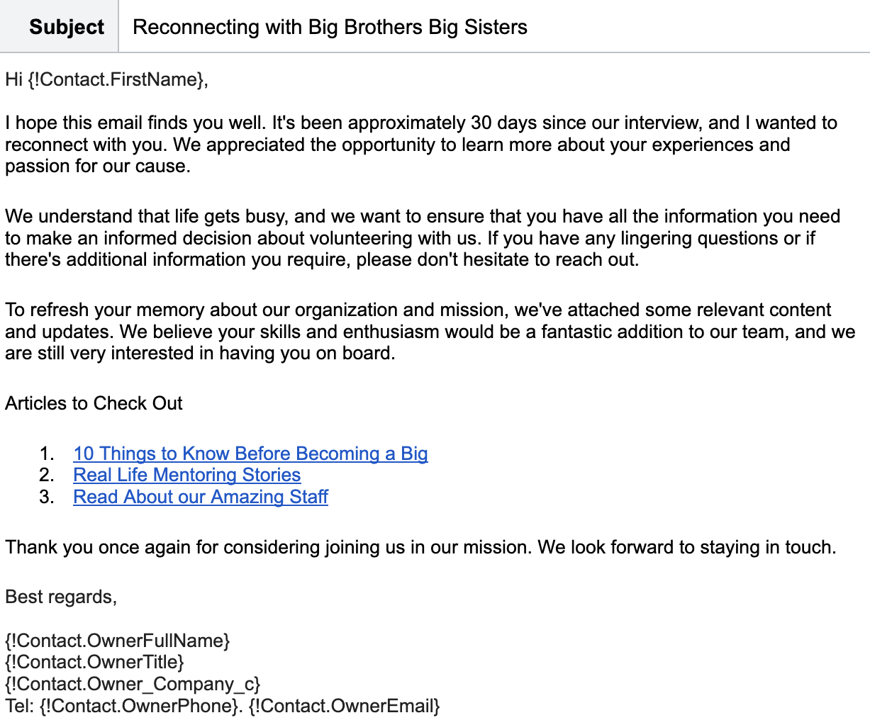
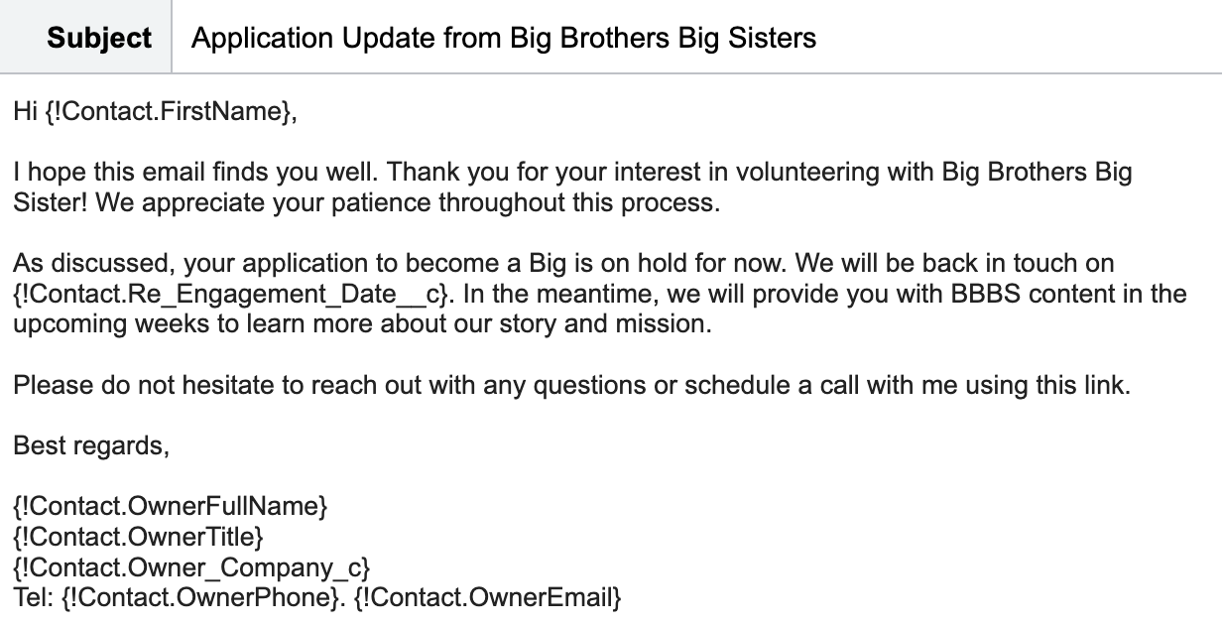
Appendix C: Post-Interview Long – Term Engagement Sample Templates
Template Name: On hold
Template Name: Reengagement 1

Slide 40
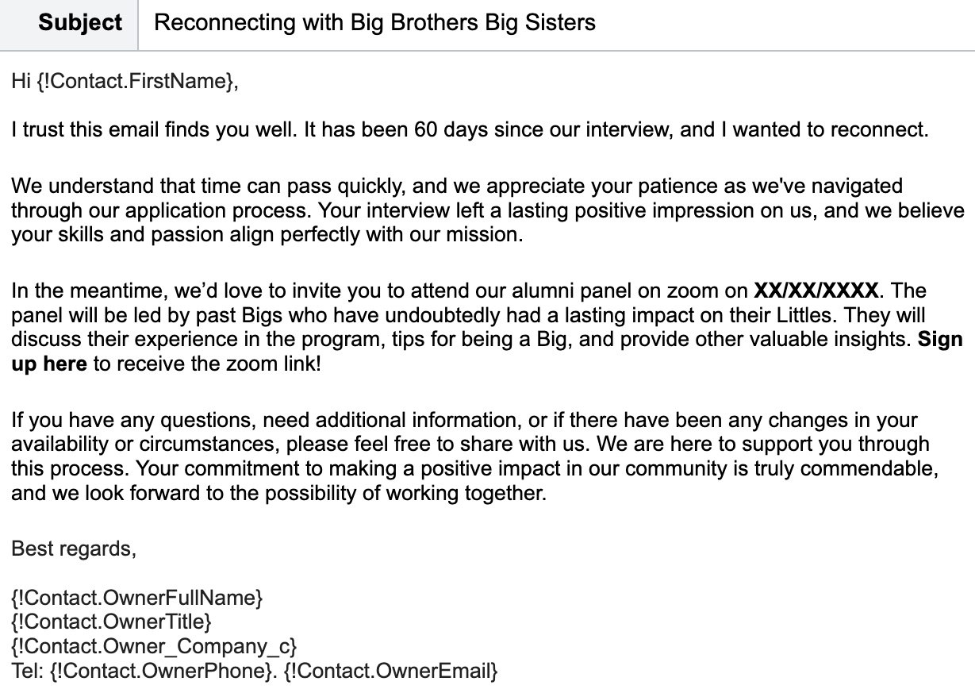
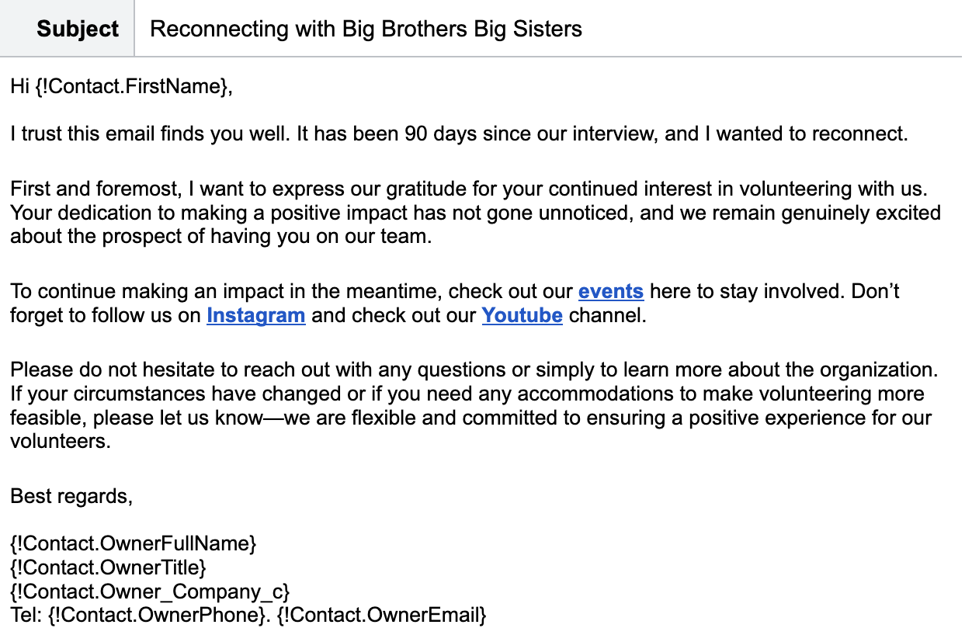
Appendix C: Post-Interview Long – Term Engagement Sample Templates
Template Name: Reengagement 2
Template Name: Reengagement 3

